Slide 1

Operating Systems
Designed by Mr. M Mudassar

Slide 2
Outline
Process
Threads
CPU Scheduling
Process Synchronization
Deadlocks
Memory Management
Virtual Memory
File System
I/O System
Disk Management
Protection
Security

Slide 3
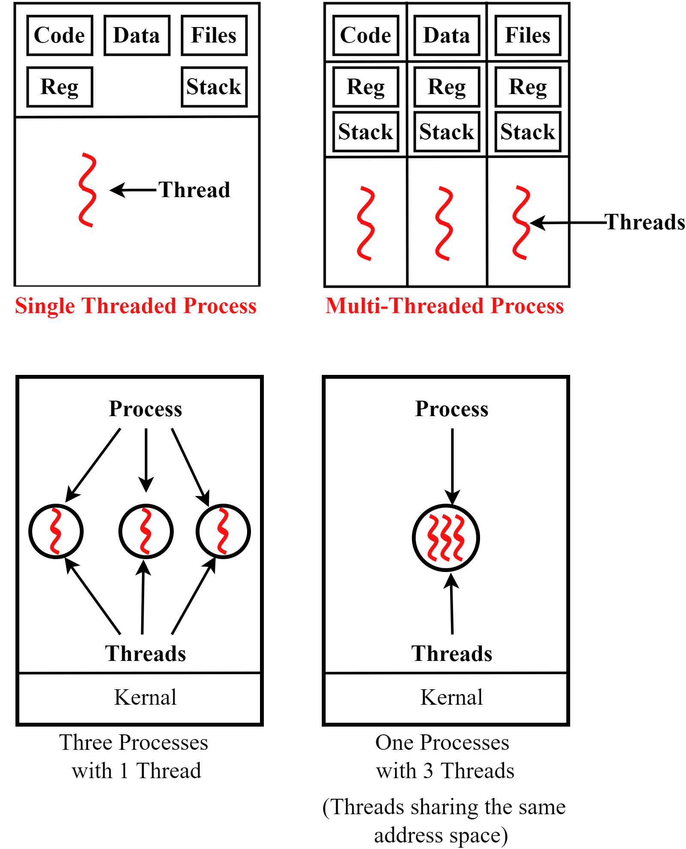
Threads Management
Threads
It is light-weight process because it needs no separate memory as process.
It is a single sequence stream within a process
Processes are used to group resources together whereas threads are the entities scheduled for execution on the CPU.
It does not require a separate program or code or data. But it requires a stack area and registers.
It does not require separate resources or memory space.
Quasi parallel

Slide 4
Threads Management
Similarities | Dissimilarities
Like process one thread can run at a time | Threads are not independent to each other
Threads executes sequentially | Unlike process, threads can access every address in the task
Threads can create children | One thread may assist the another.
If one thread is blocked, then other thread can run
Threads – Advantages
Responsiveness
Small context switching time
Fast execution of threads
Resource sharing
No need of IPC (Inter Process Communication)
Share the common data
Economy
No need to allocate separate memory space
Does not require separate program code or global data
Utilization of multi-processors architectures
Thread execution become easier

Slide 5

References
https://youtu.be/syYhYZ9YeLM

Slide 6
Thank You(Q & A)

